Slide 1

How to smoothly transition employees and faculty between systems efficiently?

Slide 2
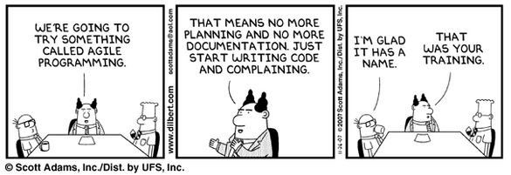
The rough transition

Slide 3
The rough transition
There are many things to consider when choosing an effective methodology for project delivery. Agile methods can provide accelerated delivery of value, the flexibility to re-prioritize scope to meet evolving requirements changes, and enhanced communication between business and technical teams. While many organizations seek the benefits agile can provide, some are not well prepared to make the changes needed to be effective with agile. This is frequently the case in large enterprises where significant legacy and associated integration requirements exist. But there are often opportunities to move toward a hybrid approach, employing agile techniques to improve project outcomes while still maintaining the organizational controls and structure seen in traditional waterfall organizations.

Slide 4
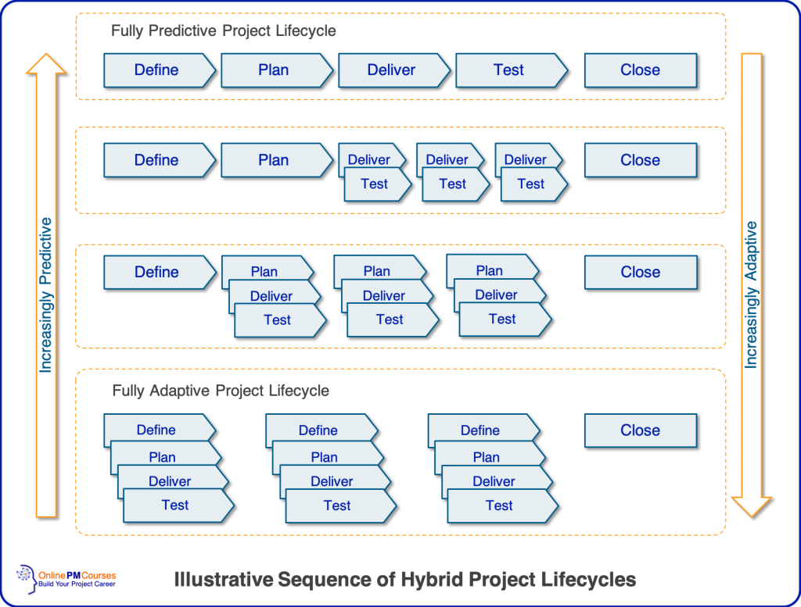
A Smoother Transition

Slide 5
Final Thoughts
Focus on a single project – A concentrated effort will help in making Agile work better
Best of both worlds: Agile isn’t better than the Waterfall methodology, and vice versa. Established methods have go-to practices that just work. With hybrid models, you pick what works best for you.
Ability to adapt: People hate change, but with hybrid project management, you must be adaptable. It takes practice, but when you commit to it, it makes change easier.
Practical experience: Be sure to study up on principles and practices so you can gain the confidence you need to know you’re doing the right thing.
Stakeholder understanding: Make sure you provide the proper level of education and discussion about your process, their involvement, and any other relevant expectations that need to be put in place.
Flexibility required: You’ve got to commit to being flexible—as individuals, as a team, and as partners. If your team and stakeholders aren’t bought into setting a plan with the possibility it might change, you’re not ready to test new ideas.
Communications: Establishing new ways of working together as a successful team requires constant, clear communication. You’ll need to develop a good system for expected communications, reporting, and meetings to keep everyone engaged in the details.
Focus on improvement: The best way to improve is to make note of issues, discuss them, and commit to getting better.

